Slide 1
MODULE II :Open Stack
Designing OpenStack Cloud Architectural Consideration – OpenStack - The new data center paradigm – OpenStack logical architecture - Nova - Compute Service.

Slide 2
What is OpenStack ?
OpenStack is a cloud operating system that controls large pools of compute, storage, and networking resources throughout a datacenter, all managed and provisioned through APIs with common authentication mechanisms.

Slide 3
What is OpenStack ?
OpenStack is one of the biggest cloud computing platforms and provides an “Infrastructure-as-a-Service” solution.
The variety of different services offered allows the administrator to install and configure the environment according to his own requirements.

Slide 4
What is OpenStack ?
Free and open-source cloud-computing software platform.
Provides services for managing a Cloud environment on the fly.
Consists of a group of interrelated projects that control pools of processing, storage, and networking resources
Provides users methods and support to deploy virtual machines in a remote environment.
State in OpenStack is maintained in centrally managed relational database (MySQL or MariaDB).

Slide 5
What is OpenStack ?
OpenStack is a cloud operating system that controls large pools of compute, storage, and networking resources throughout a datacenter, all managed and provisioned through APIs with common authentication mechanisms.

Slide 6
What is OpenStack ?
A dashboard is also available, giving administrators control while empowering their users to provision resources through a web interface.

Slide 7
What is OpenStack ?
Beyond standard infrastructure-as-a-service functionality, additional components provide orchestration, fault management and service management amongst other services to ensure high availability of user applications.

Slide 8
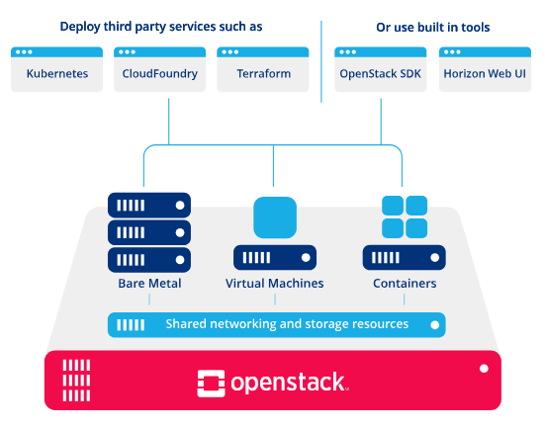

Slide 9
OPENSTACK CLOUD ARCHITECTURE
The figure represents the high level architecture of the OpenStack cloud platform, Showing how OpenStack forms the foundation of the cloud and how users interact with it using both built-in and third party tools.
OpenStack controls large pools of compute, storage and networking resources throughout a data center.
These resources are managed using APIs and dashboards
Can support different workload types such as virtual machine, containers and bare metal servers.

Slide 10
User Access and Management Layer(Top Layer)
The top of the architecture represents the interfaces and tools through which users interact with OpenStack.
Users do not directly manage servers instead, they use interfaces provided by OpenStack or external tools.

Slide 11
Built-in OpenStack Tools
Horizon Web UI
Horizon is the official web-based dashboard of OpenStack.
It provides a graphical interface for users and administrators to manage cloud resources such as instances, networks, volumes and images

Slide 12
OpenStack SDK
Provides APIs and libraries.
Allows programmatic control of cloud resource.
Provides libraries for different programming languages that allow users to interact with OpenStack services programmatically.
Useful for automation and integration with applications.

Slide 13
Third Party Tools
Kubernetes
Used for container orchestration
Runs containerized application on OpenStack infrastructure
When integrated with OpenStack, it enables the deployment and management of containerized applications using OpenStack infrastructure

Slide 14
Cloud Foundry
Is a PaaS tool that allows developers to deploy applications without managing the underlying infrastructure.
Helps developers deploy applications easily.
Terraform
Infrastructure as Code (IaC) tool.
It allows users to define cloud resources in configuration files and automatically provision them on OpenStack.
Automates the creation of VM, network and storage.
Purpose: Provide flexible and multiple ways for users to request, manage and automate cloud resources

Slide 15
Compute Resource Layer
This layer shows the different types of compute resources supported by OpenStack.
Bare Metal
Refers to physical servers without virtualization.
OpenStack supports bare metal provisioning to meet high-performance and low-latency workload requirements.

Slide 16
Virtual Machine
Virtualized compute instances
Created by virtualizing physical servers and allow multiple OS to run on the same hardware.
Containers
Provide lightweight application environment.
OpenStack supports containers either directly or through orchestration platform like kubernetes.
OpenStack can manage bare metal, virtual machine and containers within the same cloud.

Slide 17
Sharing Networking and Storage Layer
Representing the common infrastructure services shared by all compute resources.
OpenStack networking provides:
-IP address management
-Network isolation
-Connectivity between instances and external network.
Storage
Provides multiple storage options:
-Block storage for virtual machines
-Object storage for scalable datastorage

Slide 18
The new data center paradigm
The new data center paradigm refers to the transformation of traditional data centers into virtualized, cloud-enabled, software-defined, and automated infrastructures.
Earlier data centers were:
Hardware-centric
Manually managed
Rigid and difficult to scale
Modern data centers are:
Software-defined
Highly automated
Scalable and elastic
Cloud-integrated
This shift is driven by technologies such as virtualization, cloud computing, SDN, and containerization.

Slide 19
Traditional Data Center Model (Old Paradigm)
In the traditional model:
🔹 Dedicated Hardware
Each application runs on a separate physical server.
🔹 Manual Configuration
Network, storage, and servers are configured manually.
🔹 Low Utilization
Servers often use only 10–20% of their capacity.
🔹 High Capital Expenditure (CapEx)
Organizations purchase hardware in advance.
🔹 Static Infrastructure
Scaling requires purchasing and installing new hardware.
🔹 Silo-Based Architecture
Compute, storage, and networking teams work separately.

Slide 20
Limitations of Traditional Model
Resource wastage
Slow deployment (weeks/months)
High maintenance cost
Poor scalability
Complex disaster recovery

Slide 21
The New Data Center Paradigm (Modern Approach)
The new paradigm is built on abstraction, virtualization, automation, and cloud services.
Instead of managing hardware directly, infrastructure is managed through software.
Key Technologies Enabling the New Paradigm:
Virtualization
Virtualization abstracts physical hardware into multiple virtual resources.
Example:
One physical server → Multiple Virtual Machines (VMs)
Hypervisors such as VMware ESXi enable this capability.
Benefits:
Higher utilization
Server consolidation
Reduced hardware cost

Slide 22
Cloud Computing
Cloud computing provides on-demand access to resources.
Service Models:
IaaS (Infrastructure as a Service)
PaaS (Platform as a Service)
SaaS (Software as a Service)
Cloud platforms like OpenStack enable private cloud deployment.
Key Characteristics:
On-demand self-service
Broad network access
Resource pooling
Rapid elasticity
Measured service

Slide 23
Software-Defined Infrastructure (SDI)
Software controls compute, storage, networking.
API-based management.
🔹 Software-Defined Compute
Virtual machines instead of physical servers.
🔹 Software-Defined Storage (SDS)
Storage pooled and dynamically allocated.
🔹 Software-Defined Networking (SDN)
Organizations like Open Networking Foundation standardize SDN principles.
Network behavior is centrally controlled via software controllers.
Benefits:
Centralized control
Network automation
Better security policies

Slide 24
Automation and Orchestration
Modern data centers use:
Infrastructure as Code (IaC)
Automated provisioning
Policy-based management
This eliminates manual configuration and reduces human errors.

Slide 25
THE OPENSTACK LANDSCAPE
OpenStack is broken up into services to allow you to plug and play components depending on your needs.
The openstack map gives you an “at a glance” view of the openstack landscape to see where those services fit and how they can work together.

Slide 26
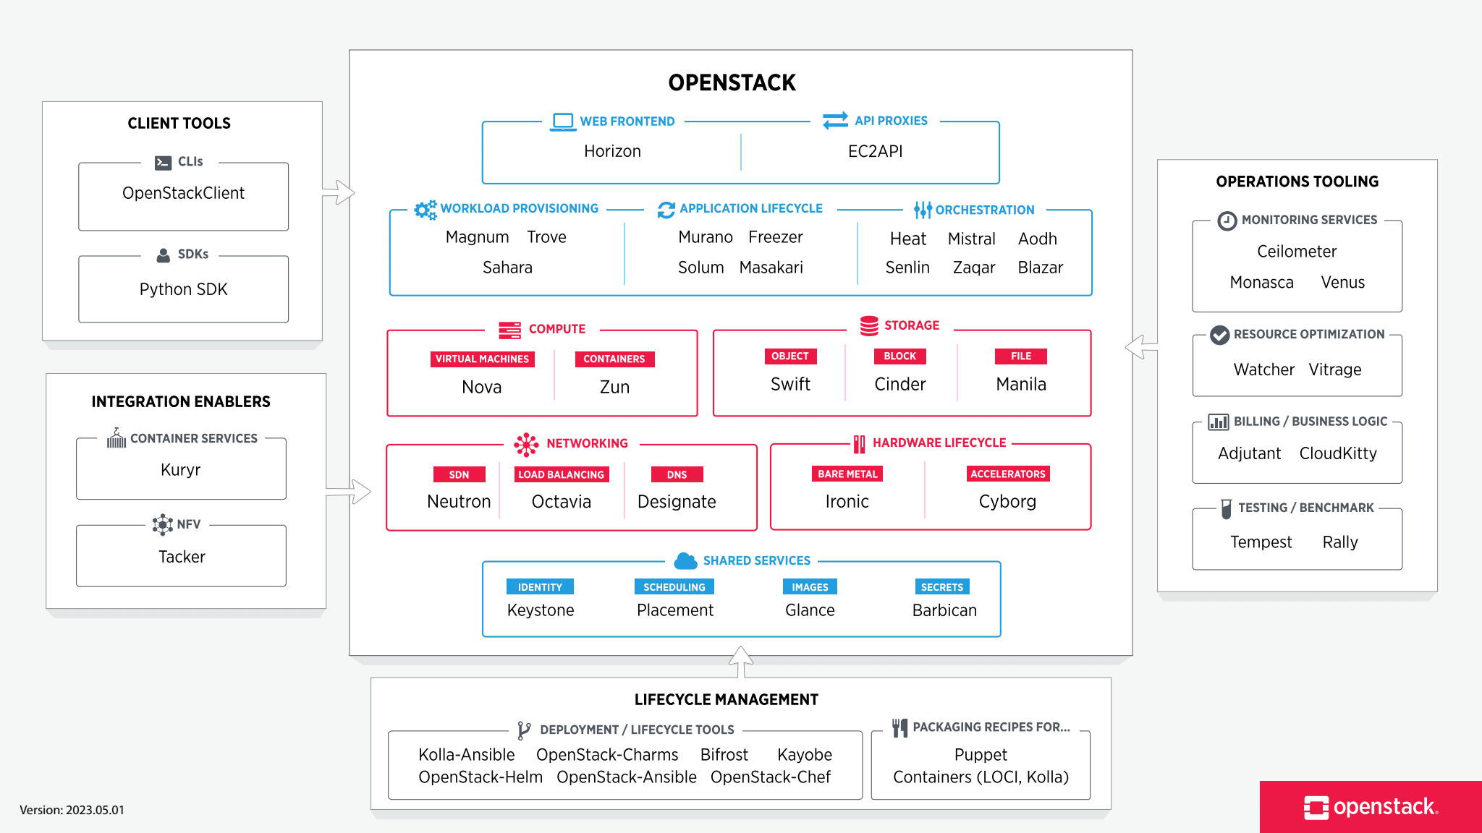

Slide 27
OpenStack components :
Core OpenStack Components include
OpenStack services,
Operations tooling,
Add-Ons to Services and
Integration enablers.

Slide 28
OpenStack components : Nova
Cloud computing fabric controller, main part of an IaaS system.
It is designed to manage and automate pools of computer resources

Slide 29

OpenStack components : Nova

Slide 30
OpenStack components : Keystone
Provides identity services for OpenStack.
A central list of users/permissions mapped against OpenStack services.
Provides multiple means of access.

Slide 31
OpenStack components : Glance
Provides image services to OpenStack. "images" refers to images (or virtual copies) of hard disks.
Used as templates for deploying new VMs.

Slide 32
OpenStack components : Glance
Provides image services to OpenStack. "images" refers to images (or virtual copies) of hard disks.
Used as templates for deploying new VMs.

